Slide 1
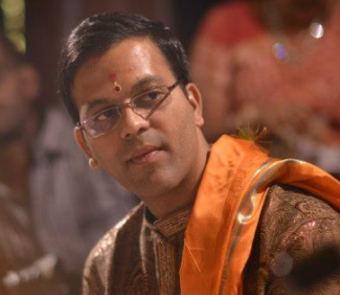
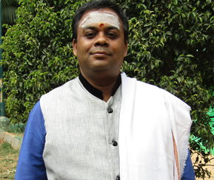
Management Aspects in
Sundarakandam of Valmiki Ramayanam
राम राम राम
जयतु संस्कृतम्
राधेश्याम
जयतु मनुकुलम्
|| ॐ ||
PRESENTERS
What can we expect ?
This generic talk on Sundarakandam will cover key management aspects in Sundarakandam
Leadership principles
Communication management
Employee behavior & Maturity curve,
Conflict handling, problem solving.
Stress management,
Anger management,
What if analysis, etc
Viswanathan P
CEO
Vyoma Labs
Venkatasubramanian P
Co-Founder;
Vyoma Labs
When: Tuesday 12 June 2018, 7 PM
Where: Sri Lakshmi Temple
117 Waverly Street, Ashland, MA 01721
Presented by:
Vyoma Labs is a non-profit company working for the promotion of
Sanskrit through technology from the past 6 years.
FREE ADMISSION - ALL ARE WELCOME

